Slide 1
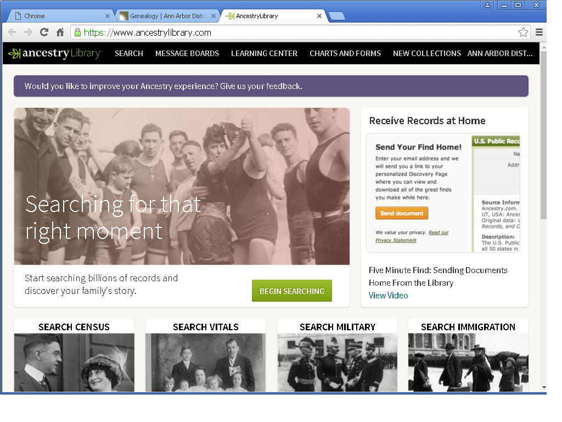
Ancestry Library Edition

Slide 2
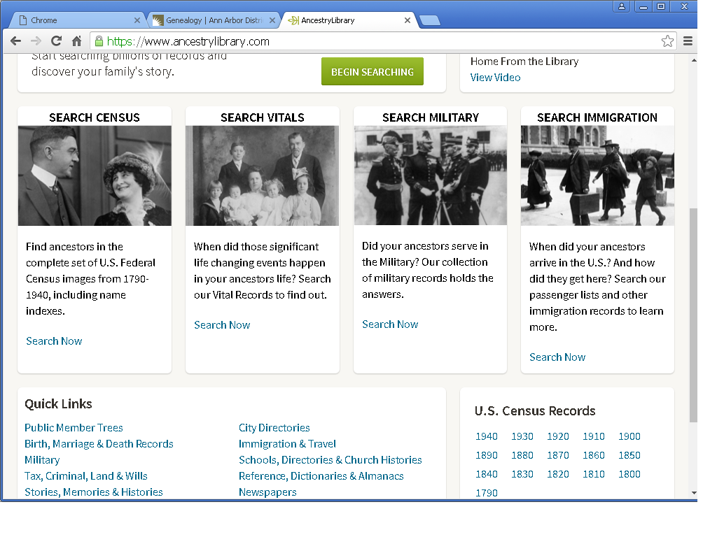
Begin Searching (mid screen)

Slide 3
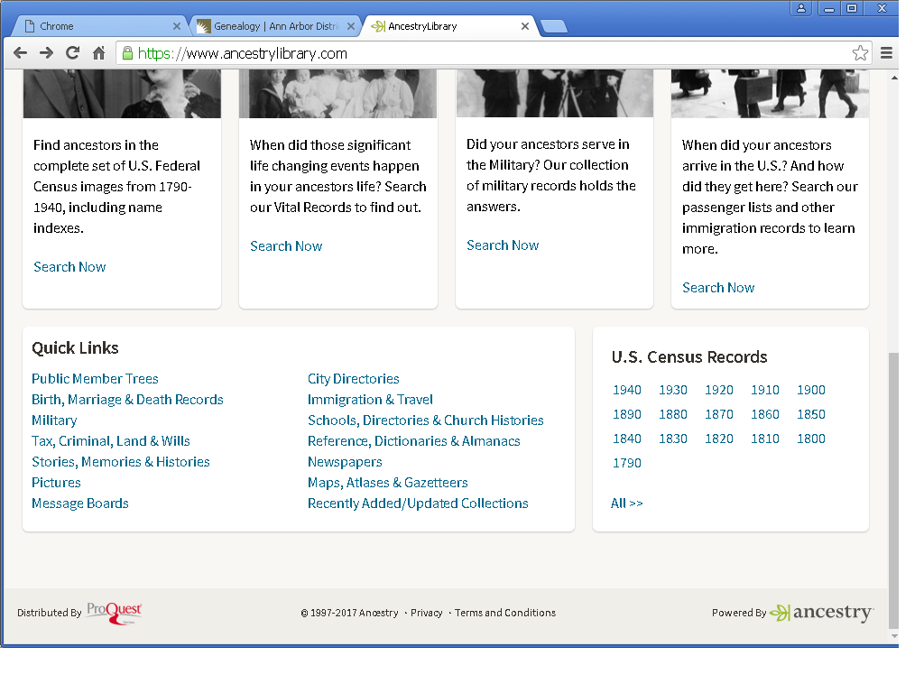
Quick Links (lower screen)

Slide 4
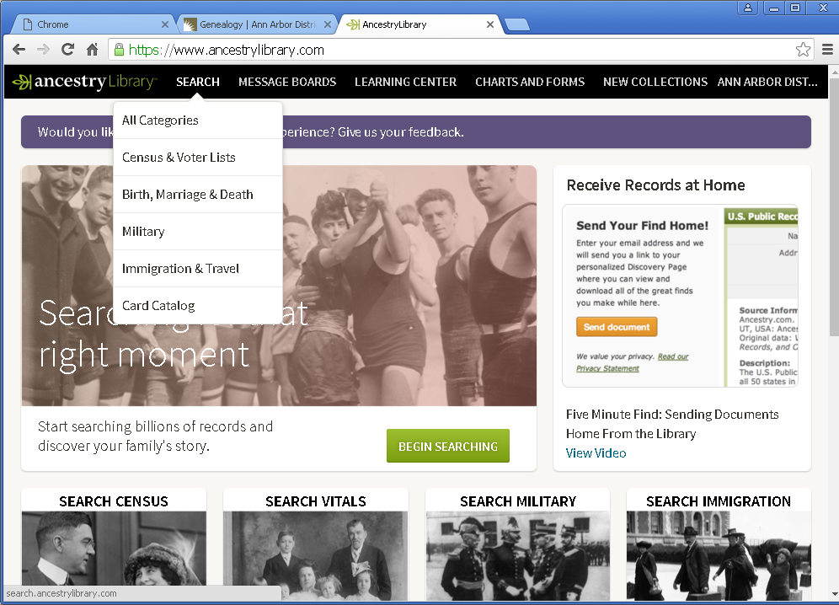
SEARCH

Slide 5
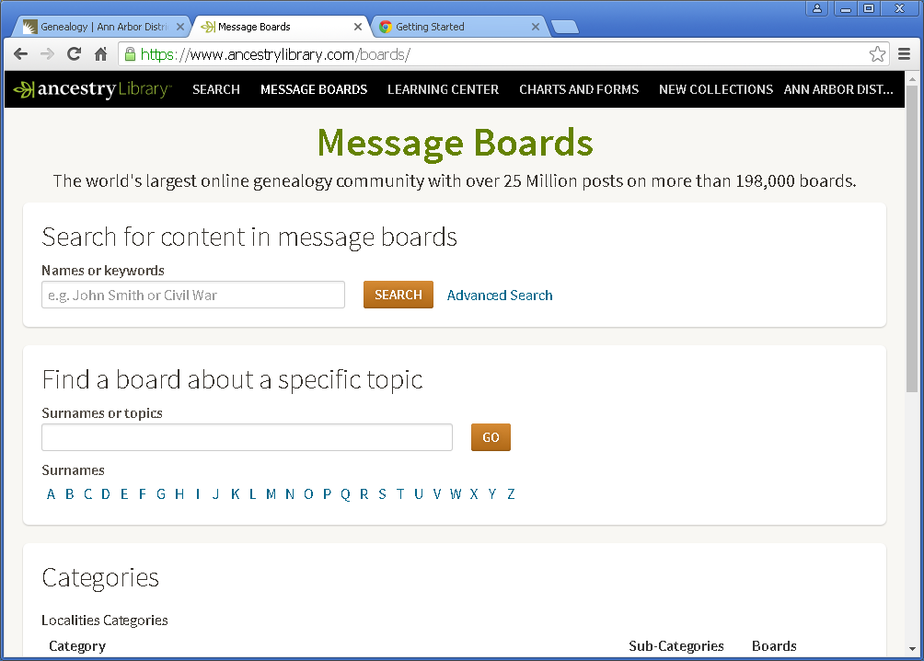
Message Boards

Slide 6
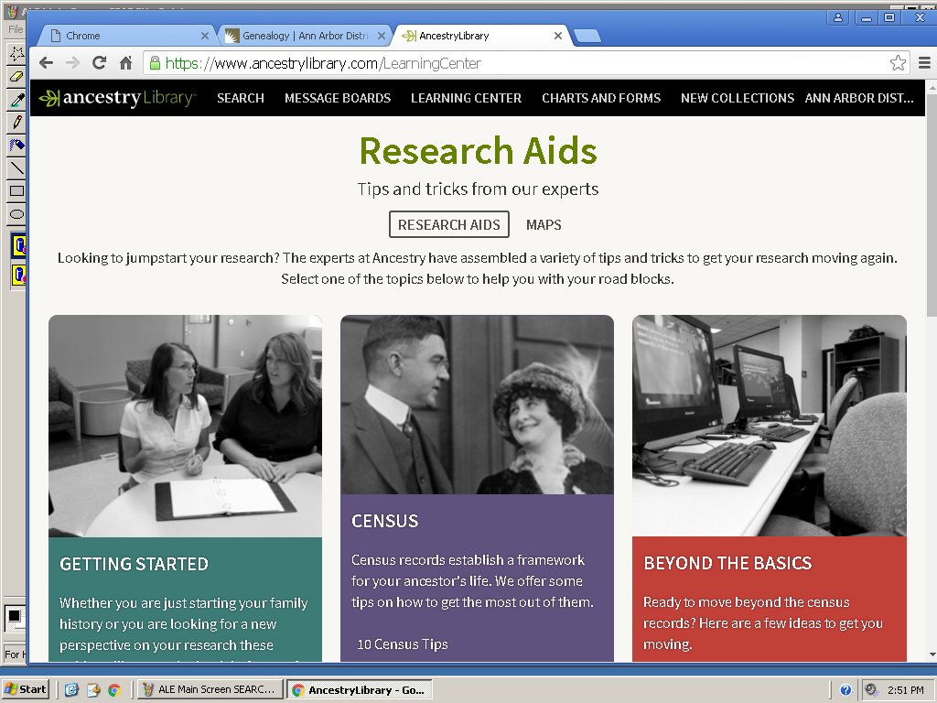
Learning Center – Research Aids

Slide 7
Learning Center Research Aids

Slide 8
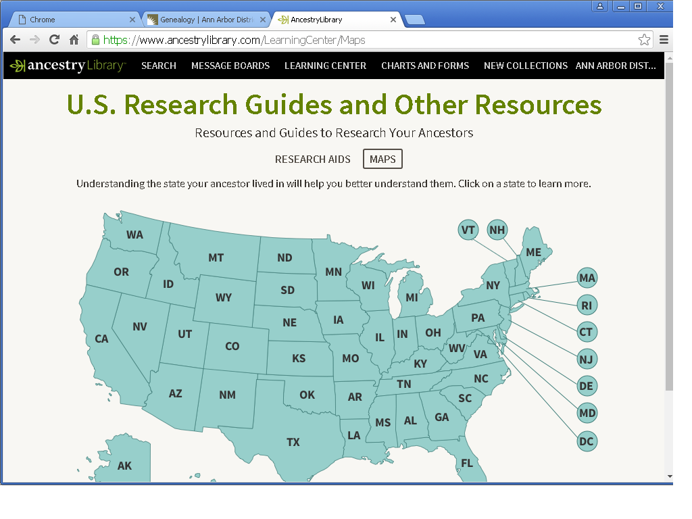
Learning Center - Maps

Slide 9
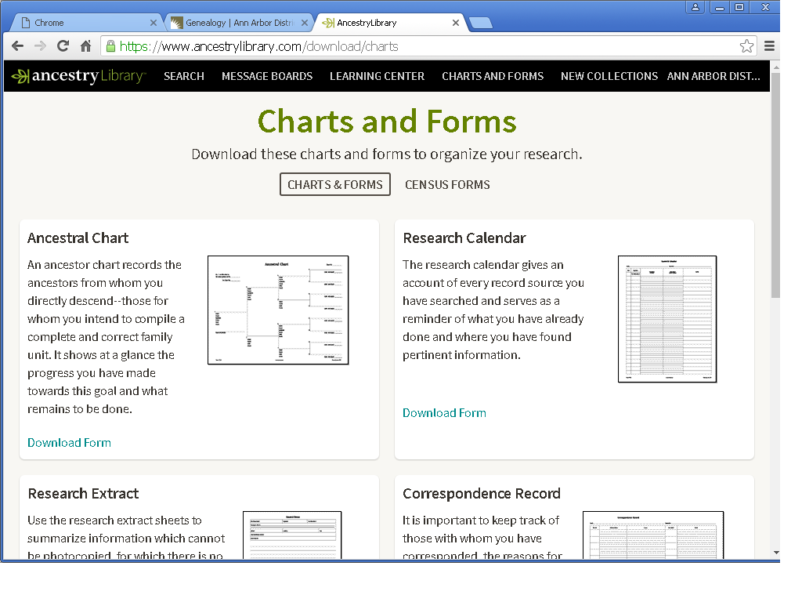
Charts & Forms

Slide 10
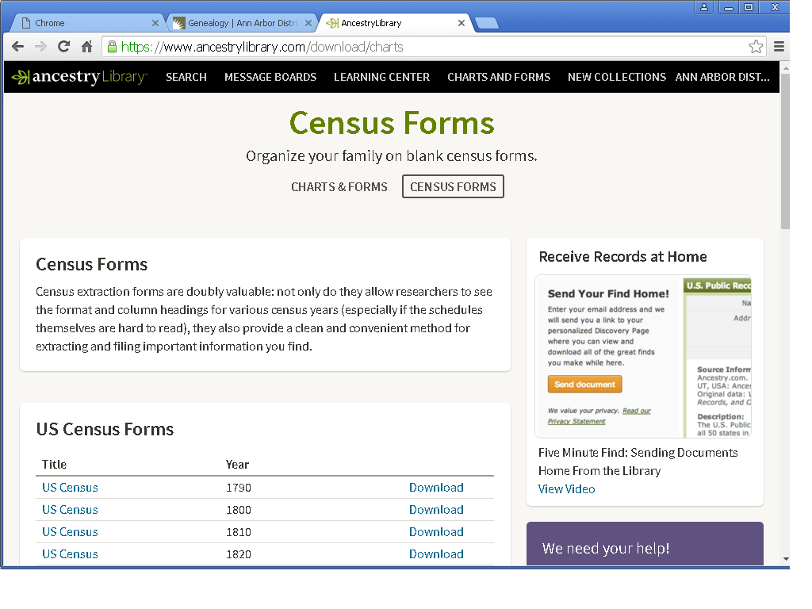
Charts & Forms - Census

Slide 11
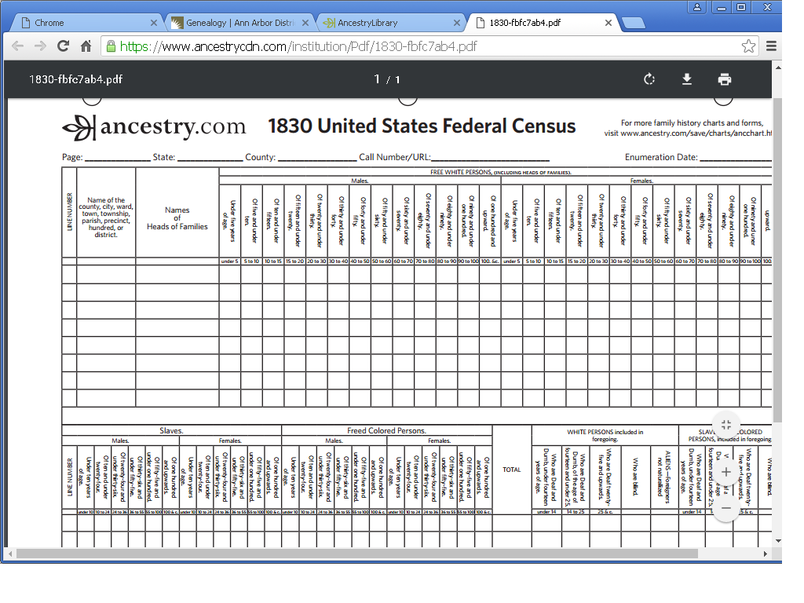

Slide 12
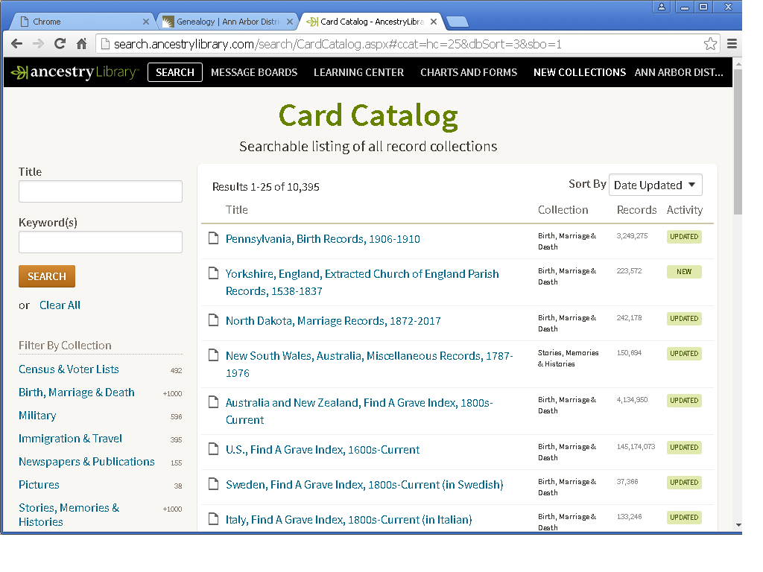
New Collections aka The Card Catalog

Slide 13
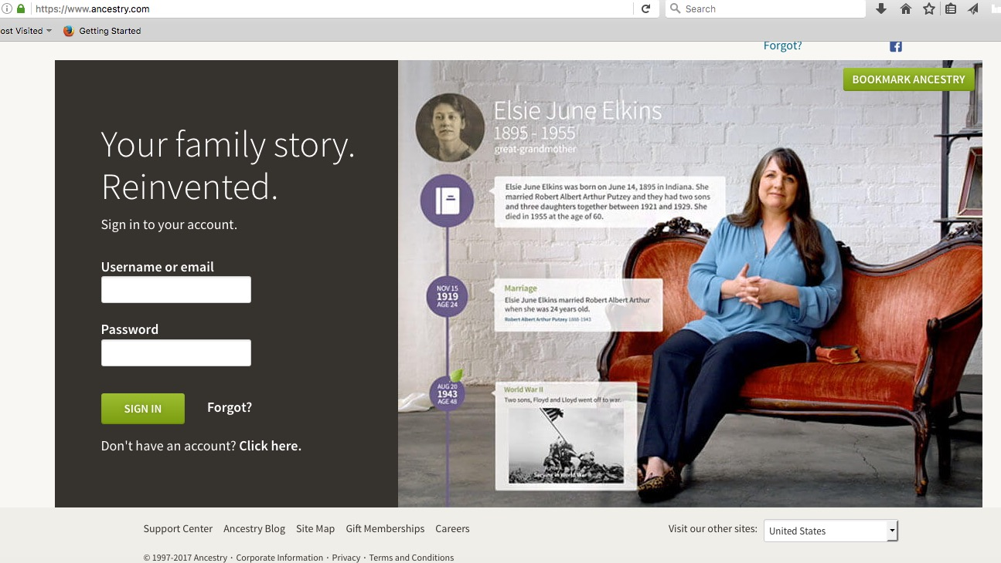
To create a free account… just use the site map

Slide 14
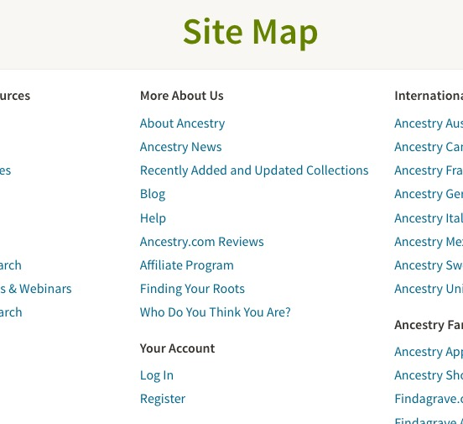
Quickest way to register for a free Ancestry.com account

Slide 15
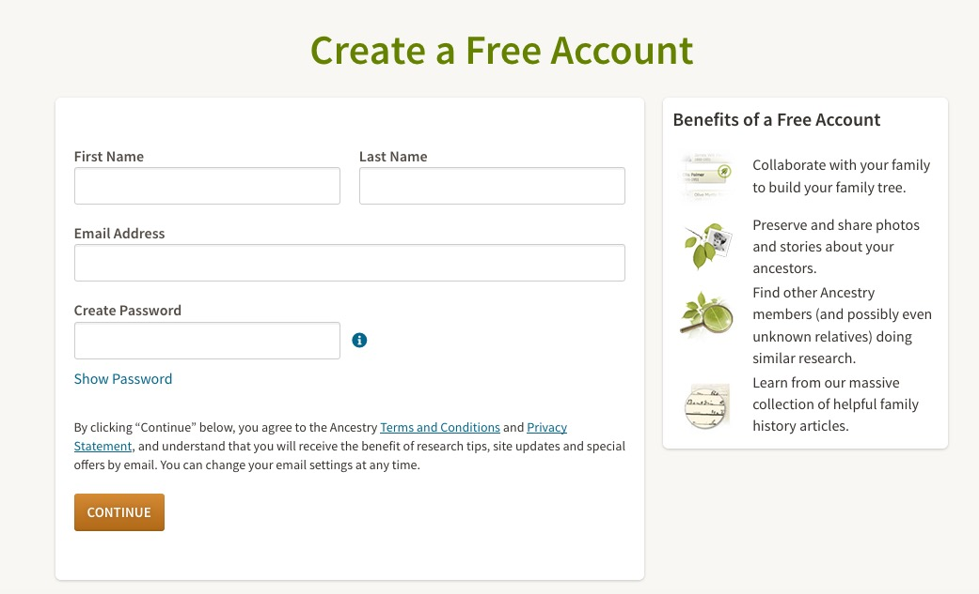
Free accounts are limited, but some things are available

Slide 16
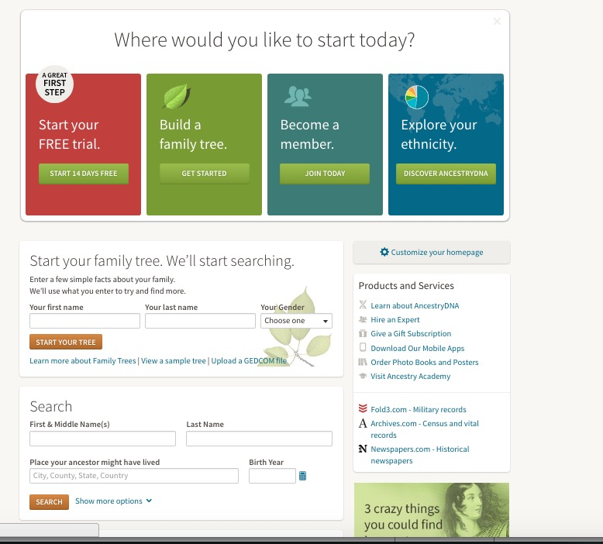
Free Account splash screen

Slide 17
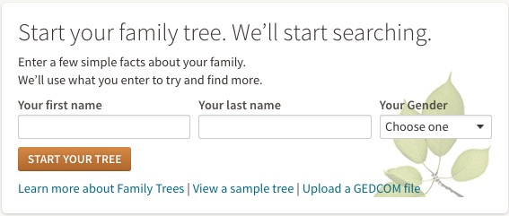

Slide 18
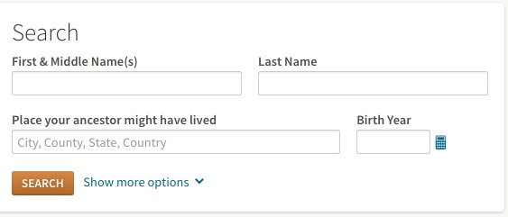

Slide 19
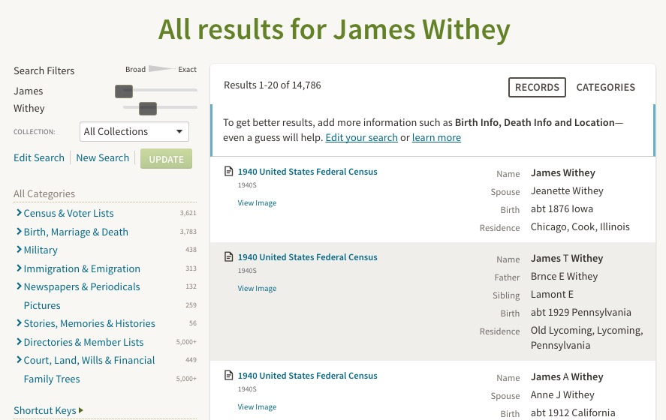

Slide 20
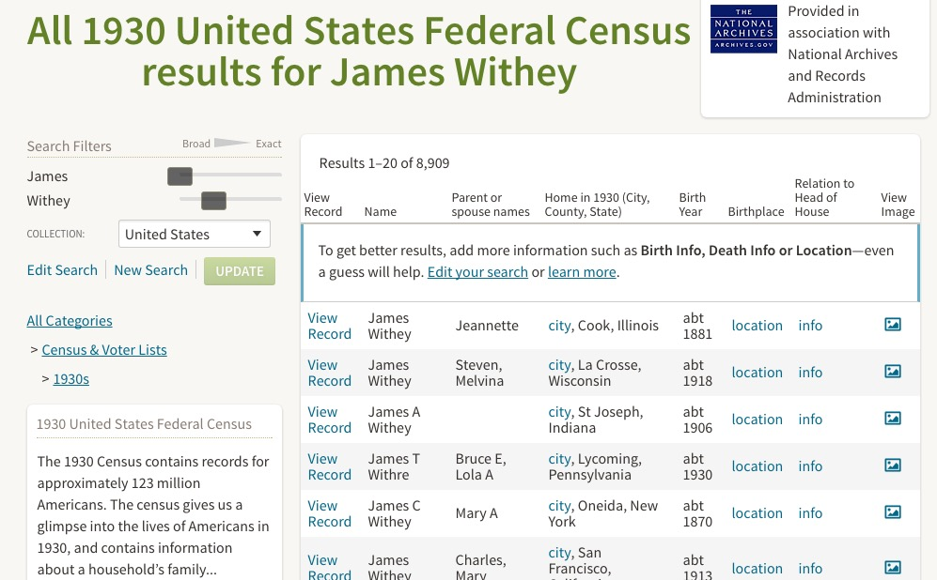

Slide 21
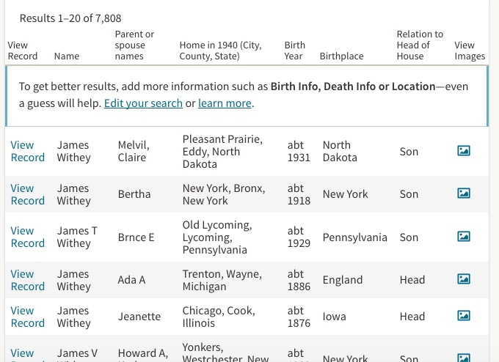

Slide 22
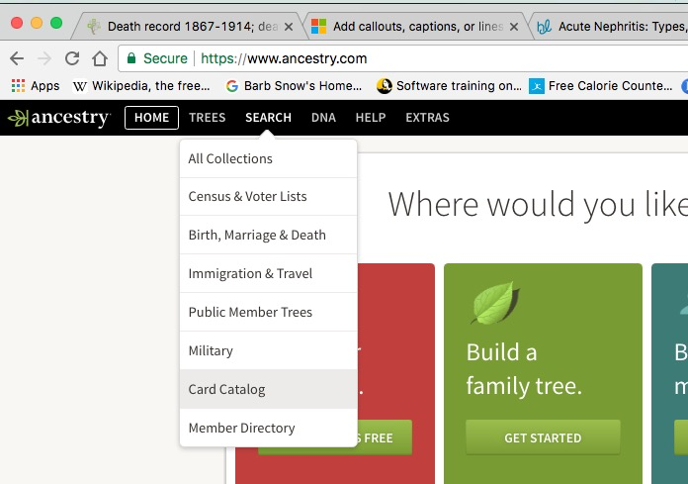

Slide 23
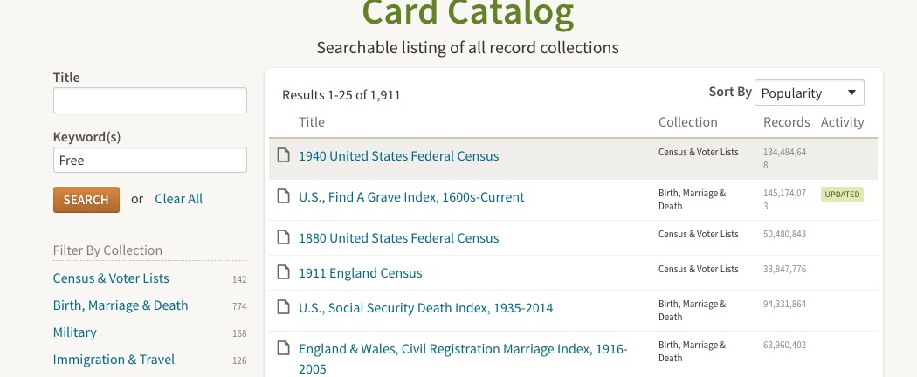

Slide 24
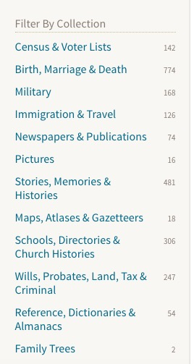
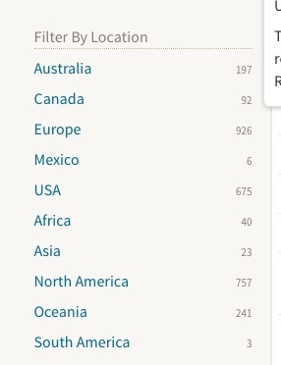
Filter to narrow down results
Filter by Collection
Filter by Location

Slide 25
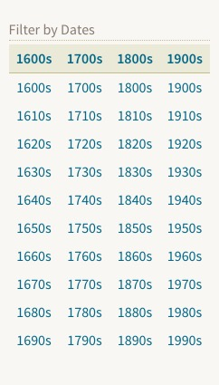
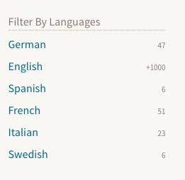
Filter by date
Filter by language

Slide 26
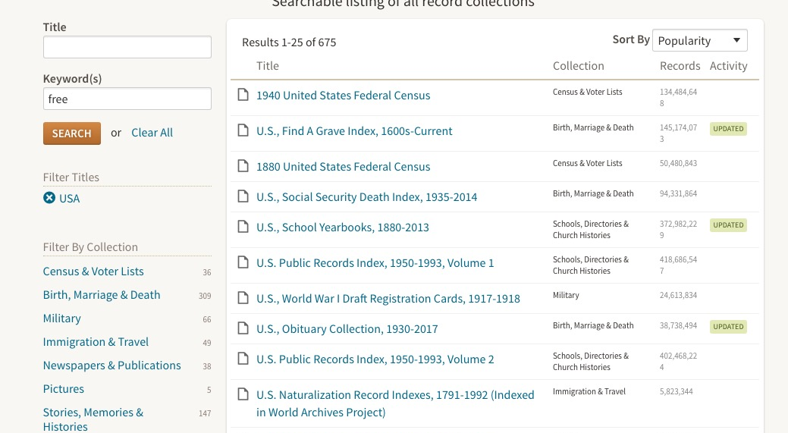
Not all really are in the “Free” group

Slide 27
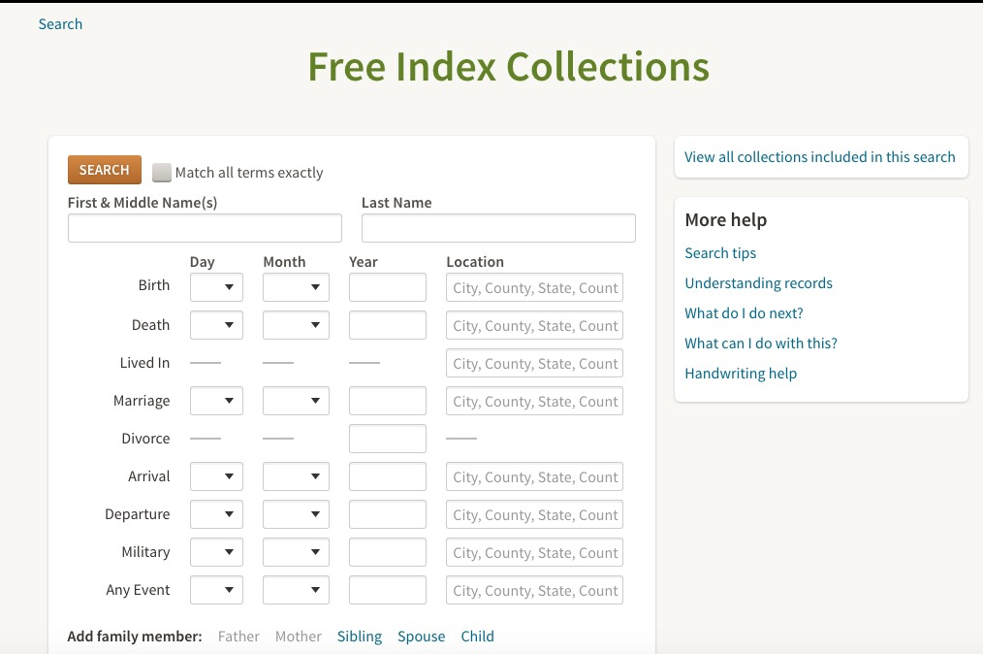
http://search.ancestry.com/search/group/freeindexacom
Copy this url. I can’t get to it from Ancestry.com

Slide 28
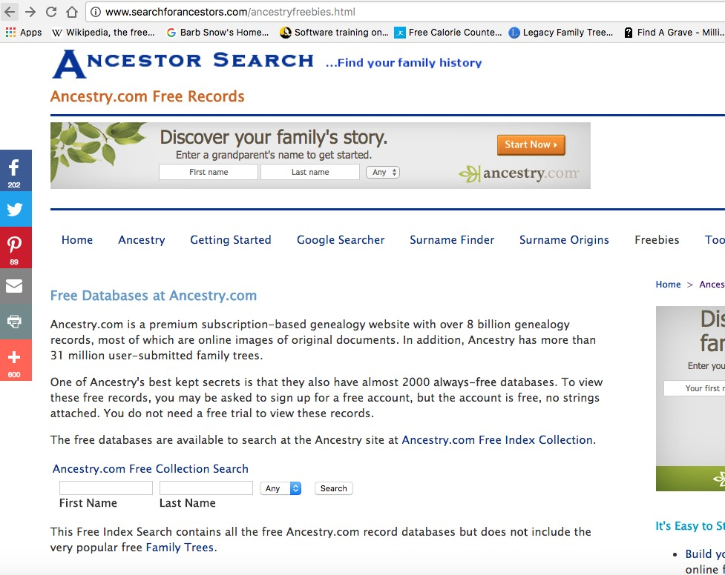
http://www.searchforancestors.com/ancestryfreebies.html

